Slide 2
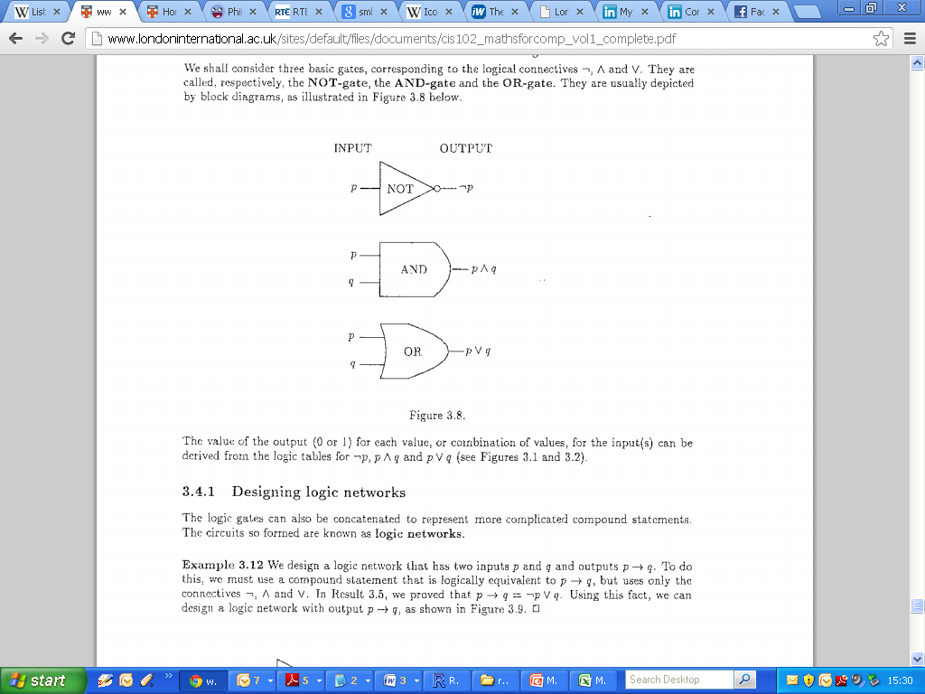
Logic: Logic Gates
Designing Logic Gates
Output of a given network

Slide 3
Logic: Logic Gates
(2008 Q3b)
Construct a logic network that accepts as inputs p and q, which may independently have value 0 or 1, and give as final output ¬(p ∧ ¬q) .
Show that this expression is equivalent to p → q. (i.e. using truth tables)

Slide 4
Logic: Logic Gates

